Slide 1
REPORT ON
ADVERTISEMENT RECALL AND EVALUATION
FOR
NASSER SPORTS - Y2015
--------------------------------------------
CLIENT: NASSER SPORTS CENTER

Slide 2
TABLE OF CONTENTS
INTRODUCTION
2. INFORMATION NEEDS
3. RESEARCH DESIGN
4. SAMPLE PROFILE
5. FINDINGS AND ANALYSES

Slide 3
I. Introduction
Nasser Sports Center (NSC) conducted a sale and promotion campaign in May/June 2015 through various medium such as In-store, Outdoor, Newspapers and Flyers.
Hence it wished to assess and evaluate its campaign to determine the recall level as well as the main message conveyed through these campaigns, as perceived by the General Public in Kuwait.
The study entailed the need to examine all aspects related to the Spontaneous Advertisement recall, media in which recalled, Aided recall, key message and evaluation of certain key elements.
All methods and procedures used in this survey comply with the ICC/ESOMAR International Code of Marketing and Social Research Practice, and the rules and regulations of the Central Statistical Office, Ministry of Planning, Kuwait.

Slide 4
II. Information Needs
The Information needs of the study are as follows:
Recall of advertisement for Fashion and Footwear stores in last 3 months
→ Spontaneous Awareness
Top-of-mind
Other mentions
→ Aided Awareness
→ Media in which advertisements were recalled
Type/Description of Nasser Sports Center advertisements recalled spontaneously and their Incidence
3. Post Commercial Registration(PCR) of Nasser Sports Center Advertisement (On Aiding Nasser Sports Ad)
→ Incidence of seeing the Advertisement
→ Main message conveyed in the advertisement
→ Evaluation of the advertisement on a 5 point rating scale on the
following elements:
Impressiveness
Informative nature
Ease of understanding
Effectiveness
Credibility
Colors used
Way of writing
Pictures in the advertisement

Slide 5
III. Research Design
Adult, 18 yrs and above, among Kuwaitis, Arab Expats & Non Arabs across all the Governorates of Kuwait
TARGET SEGMENT
RESEARCH INSTRUMENT
Face to face Interviews
Semi structured questionnaire in English and Arabic
METHODOLOGY
SAMPLE
Total Sample N = 419

Slide 6
IV. Sample Profile
Base : Total Sample = 419

Slide 7
IV. Sample Profile
Base : Total Sample = 419

Slide 8
FINDINGS
AND
ANALYSIS

Slide 9
Incidence of having seen/heard advertisements of Fashion and footwear stores in the last 3 months - By Total Sample, Gender & Nationality
Three-fourth of Respondents have seen/heard advertisements of Fashion & footwear stores. This is higher among Males(79%) as opposed to Females(67%). This is highest among Non Arabs as opposed to Kuwaitis and Arab expats.
%
Base: Total Sample = 419

Slide 10
Spontaneous recall of advertisements for Branded Fashion & Footwear Stores in last 3 months
By Total Sample
Top of mind recall is highest for Nasser Sports Center(32%), followed by Centerpoint(18%), Red Tag(17%), etc.
Including Other mentions the Total spontaneous awareness increased considerably with Nasser Sports upto(62%), Centerpoint (53%), Red Tag(50%), etc.
%
62
53
50
45
12
14
6
5
Base: Have seen/heard advertisements in last 3 months = 308

Slide 11
Total Spontaneous recall of advertisements for Branded Fashion & Footwear Stores in last 3 months
By Total Sample & Nationality NOT DONE
Analysing by nationality the Total spontaneous recall for Nasser Sports is highest for Non Arabs, followed by Arab expats and Kuwaitis
%
Base: Have seen/heard advertisements in last 3 months = 308

Slide 12
Total Awareness of of advertisements for Branded Fashion & Footwear Stores in last 3 months(After Aiding)
Total Sample
After aiding for advertisement recall, it increased substantially for Nasser Sports(96%), followed by Centerpoint (71%), Red Tag(62%), Max(57%), etc.
%
Base: Have seen/heard advertisements in last 3 months = 308

Slide 13
Media in which Seen/Heard advertisements for branded fashion and footwear stores
By Total Sample
Fashion & Footwear Stores | TV | Newspaper & Magazine | Outdoor | Do not remember
 | (%) | (%) | (%) | (%)
Centerpoint | 2 | 20 | 83 | 6
Nasser Sports Center | 1 | 29 | 84 | 3
Max | 1 | 15 | 78 | 12
H&M | 9 | 15 | 59 | 19
Debenhams | 2 | 16 | 69 | 20
Red Tag | 3 | 17 | 86 | 5
Nike | 3 | 27 | 77 | 7
Base: Have seen/heard advertisements in last 3 months = 308

Slide 14
Advertisements seen/heard of Nasser Sports spontaneously - By Total Sample, & Nationality
AD.1 - SALE UPTO 50%
AD.2 - SALE UPTO 50% SHOWING PICTURES OF T SHIRT, EQUIPMENT, ETC.
(72%) recalled this Advertisement Spontaneously
30% have recalled this Advertisement Spontaneously
%
%
Base: Have seen Nasser Sports advertisement in a last 3 months = 297

Slide 15
Incidence of having seen/heard Nasser Sports advertisements - By Total Sample, & Nationality
AD.3 - ADVERTISEMENT FOR LUGGAGE
AD.4 - FLYER SHOWING SALE UPTO 50%
(28%) recalled this Advertisement Spontaneously
37% have recalled this Advertisement Spontaneously
%
%
Base: Have seen Nasser Sports advertisement in a last 3 months = 297

Slide 16
Proven Commercial Registration (PCR) – Nasser Sports Ad Campaign
In order to ascertain the PCR for the Nasser Sports Advertisement respondents were shown advertisement of Nasser Sports’ recent campaign. Respondents were first shown the advertisement and were then investigated for their incidence of seeing this Ad Campaign. Thereafter, all respondents were asked to evaluate them on the following aspects.
- Main message of the advertisement
- Evaluation rating of the advertisement on a 5 point scale for the
following:
- Impressiveness of the ad
- Informative nature of the ad
- Credibility of the ad
- Ease of understanding the ad
- Effectiveness of the ad
- Colors used in the ad
- Way of writing
- Pictures used in the ad
Overall liking of the ad & reasons for Disliking the ad, if any

Slide 17
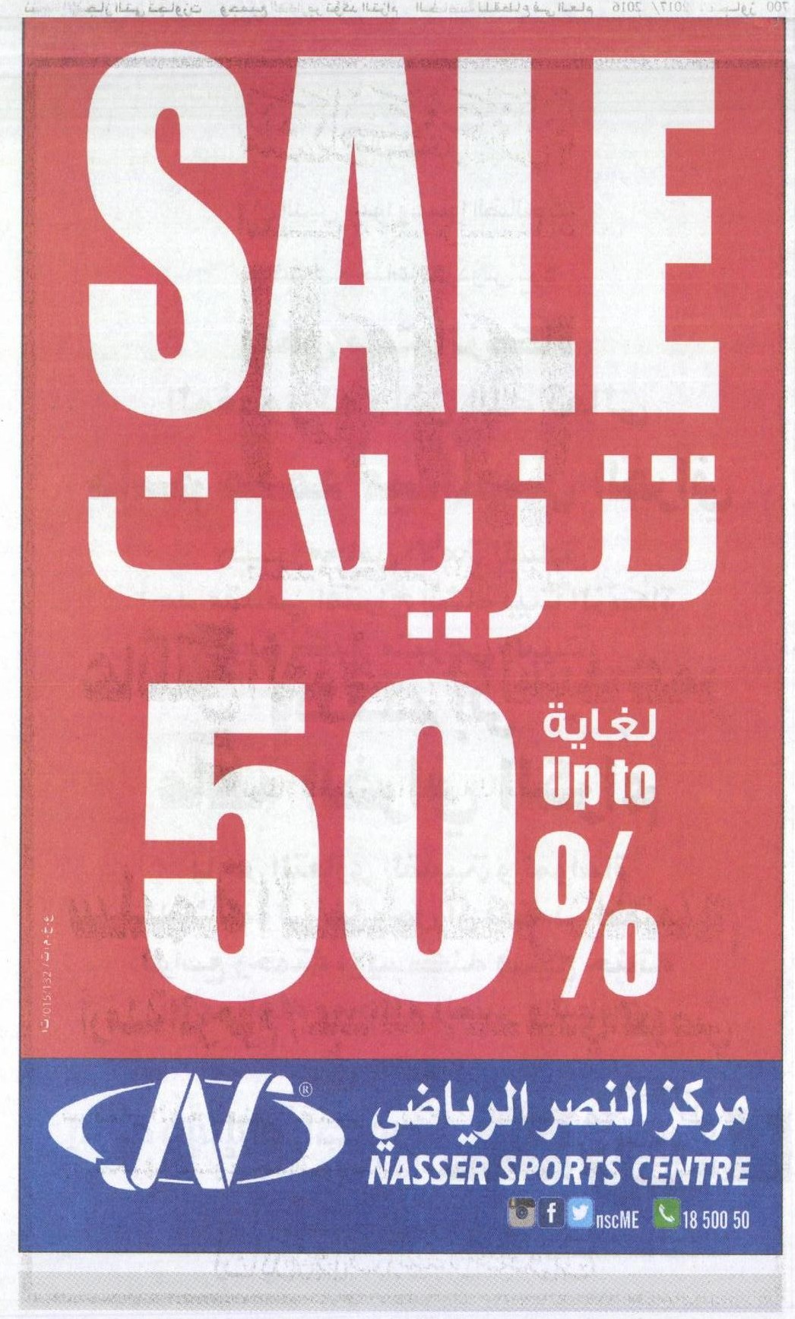
A
D
V
E
R
T
I
S
E
M
E
N
T
1

Slide 18
Incidence of having seen/heard Nasser Sports advertisement – AD 1
By Total Sample, & Nationality
Majority (72%) recall this advertisement. This is highest among Non Arabs as opposed to other two Nationalities.
%
Base: Total Sample = 419

Slide 19
MAIN MESSAGE CONVEYED
By Total Sample
%
Base: Seen the Advertisement = 302

Slide 20
Impressiveness of Advertisement
Total Sample & Nationality
Informative nature of Advertisement
Total Sample & Nationality
Top 2 Boxes = 69 65 72 73 65 70 59 67
Total sample (419)
Kuwaitis
(192)
Arab Expats
(157)
Non Arabs
(70)
Total sample (419)
Kuwaitis
(192)
Arab Expats
(157)
Non Arabs
(70)

Slide 21
Credibility of the Advertisement
Total Sample & Nationality
Ease of understanding the Advertisement
Total Sample & Nationality
Top 2 Boxes = 76 73 88 59 75 82 66 77
Total sample (419)
Kuwaitis
(192)
Arab Expats
(157)
Non Arabs
(70)
Total sample (419)
Kuwaitis
(192)
Arab Expats
(157)
Non Arabs
(70)

Slide 22
Effectiveness of Advertisement
Total Sample & Nationality
Colors used in Advertisement
Total Sample & Nationality
Top 2 Boxes = 74 67 83 72 75 76 76 65
Total sample (419)
Kuwaitis
(192)
Arab Expats
(157)
Non Arabs
(70)
Total sample (419)
Kuwaitis
(192)
Arab Expats
(157)
Non Arabs
(70)

Slide 23
Way of writing the Advertisement
Total Sample & Nationality
Pictures in the Advertisement
Total Sample & Nationality
Top 2 Boxes = 73 76 73 66 73 76 71 65
Total sample (419)
Kuwaitis
(192)
Arab Expats
(157)
Non Arabs
(70)
Total sample (419)
Kuwaitis
(192)
Arab Expats
(157)
Non Arabs
(70)

Slide 24
Overall rating of the Advertisement
Total Sample & Nationality
Top 2 Boxes = 82 81 84 83
Total sample (419)
Kuwaitis
(192)
Arab Expats
(157)
Non Arabs
(70)

Slide 25
REASONS FOR DISLIKING THE ADVERTISEMENT
By Total Sample
Base: Average / Disliked the advertisement = 75

Slide 26
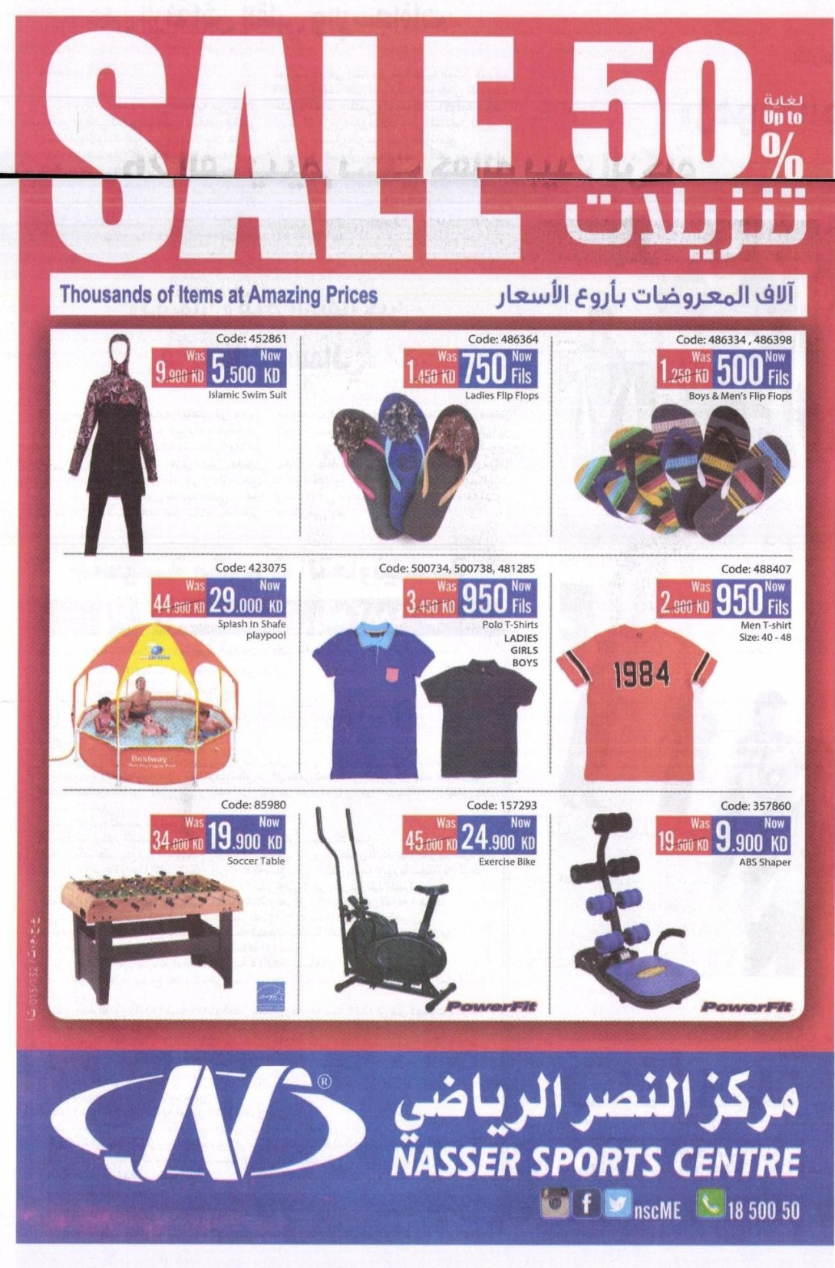
A
D
V
E
R
T
I
S
E
M
E
N
T
2

Slide 27
Incidence of having seen/heard Nasser Sports advertisement – AD 2
By Total Sample, & Nationality
About (42%) recall this advertisement. This is highest among Kuwaitis (47%) as opposed to Expat Arabs and Non Arabs.
%
Base: Total Sample = 419

Slide 28
MAIN MESSAGE CONVEYED
By Total Sample
Base: Seen the Advertisement = 176

Slide 29
Impressiveness of Advertisement
Total Sample & Nationality
Informative nature of Advertisement
Total Sample & Nationality
Top 2 Boxes = 74 71 76 81 77 74 80 81
Total sample (419)
Kuwaitis
(192)
Arab Expats
(157)
Non Arabs
(70)
Total sample (419)
Kuwaitis
(192)
Arab Expats
(157)
Non Arabs
(70)

Slide 30
Credibility of the Advertisement
Total Sample & Nationality
Ease of understanding the Advertisement
Total Sample & Nationality
Top 2 Boxes = 77 76 86 62 87 87 86 87
Total sample (419)
Kuwaitis
(192)
Arab Expats
(157)
Non Arabs
(70)
Total sample (419)
Kuwaitis
(192)
Arab Expats
(157)
Non Arabs
(70)

Slide 31
Effectiveness of Advertisement
Total Sample & Nationality
Colors used in Advertisement
Total Sample & Nationality
Top 2 Boxes = 75 71 83 73 76 80 74 75
Total sample (419)
Kuwaitis
(192)
Arab Expats
(157)
Non Arabs
(70)
Total sample (419)
Kuwaitis
(192)
Arab Expats
(157)
Non Arabs
(70)

Slide 32
Way of writing the Advertisement
Total Sample & Nationality
Pictures in the Advertisement
Total Sample & Nationality
Top 2 Boxes = 73 78 70 64 76 80 75 70
Total sample (419)
Kuwaitis
(192)
Arab Expats
(157)
Non Arabs
(70)
Total sample (419)
Kuwaitis
(192)
Arab Expats
(157)
Non Arabs
(70)

Slide 33
Overall rating of the Advertisement
Total Sample & Nationality
Top 2 Boxes = 82 81 84 83
Total sample (419)
Kuwaitis
(192)
Arab Expats
(157)
Non Arabs
(70)

Slide 34
REASONS FOR DISLIKING THE ADVERTISEMENT
By Total Sample
Base: Average / Disliked the advertisement = 54

Slide 35
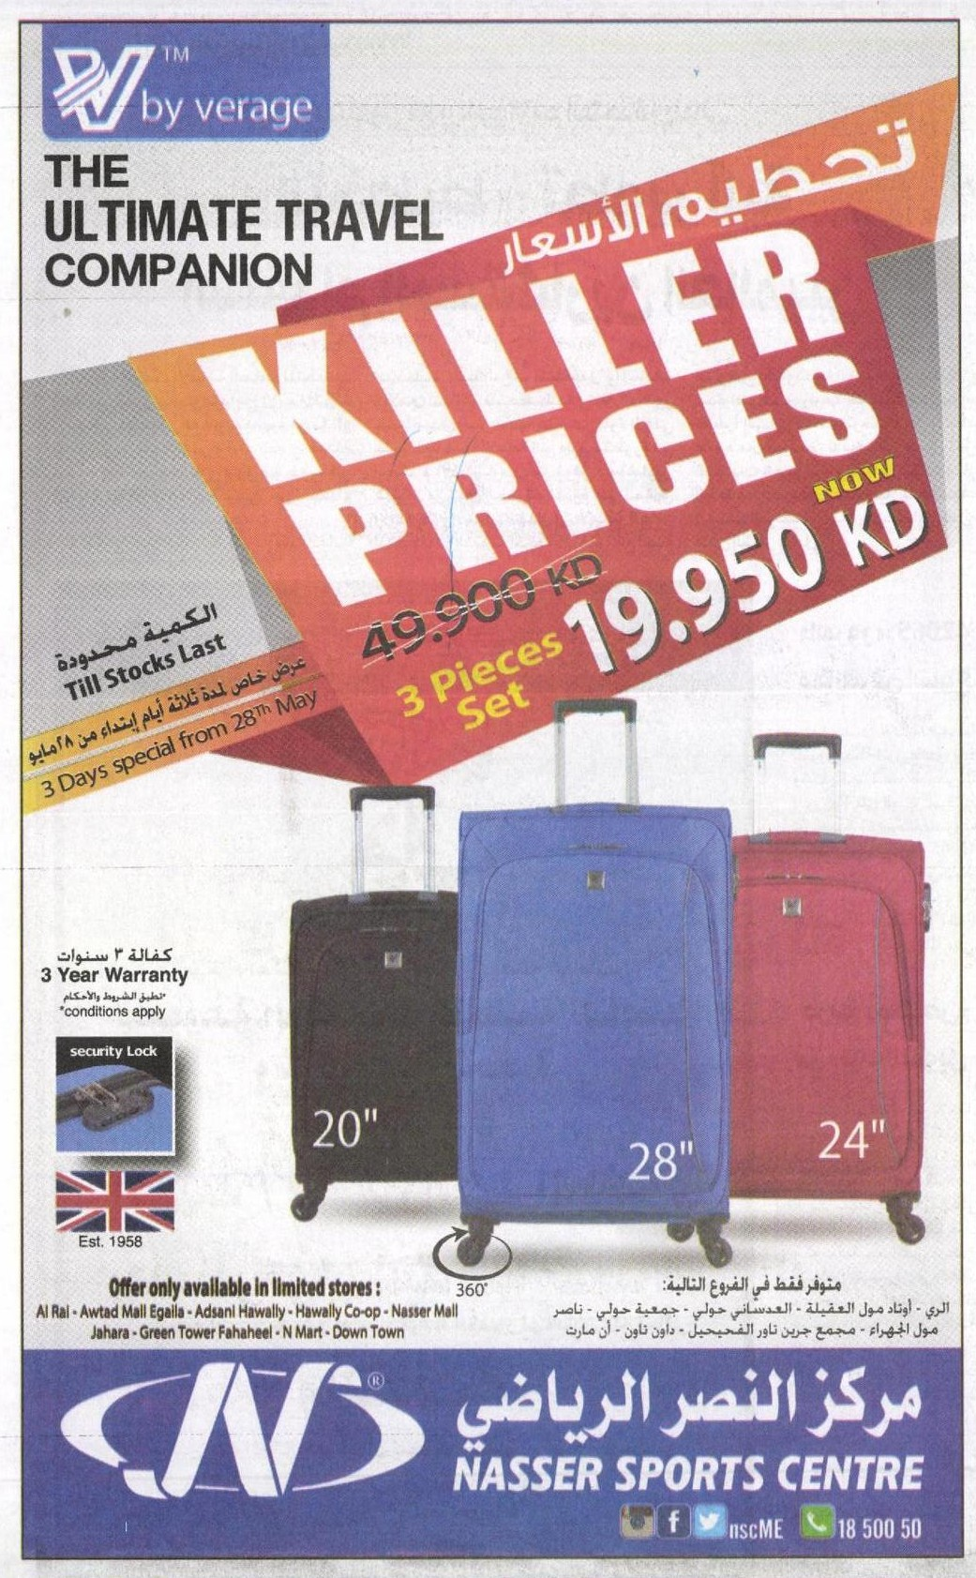
A
D
V
E
R
T
I
S
E
M
E
N
T
3

Slide 36
Incidence of having seen/heard Nasser Sports advertisement – AD 3
By Total Sample, & Nationality
About (38%) recall this advertisement. This is highest among Arab Expats (45%) and followed by Kuwaitis (40%)
%
Base: Total Sample = 419

Slide 37
MAIN MESSAGE CONVEYED
By Total Sample
Base: Seen the Advertisement = 159

Slide 38
Impressiveness of Advertisement
Total Sample & Nationality
Informative nature of Advertisement
Total Sample & Nationality
Top 2 Boxes = 72 69 80 68 76 74 81 66
Total sample (419)
Kuwaitis
(192)
Arab Expats
(157)
Non Arabs
(70)
Total sample (419)
Kuwaitis
(192)
Arab Expats
(157)
Non Arabs
(70)

Slide 39
Credibility of the Advertisement
Total Sample & Nationality
Ease of understanding the Advertisement
Total Sample & Nationality
Top 2 Boxes = 77 75 84 61 84 85 85 77
Total sample (419)
Kuwaitis
(192)
Arab Expats
(157)
Non Arabs
(70)
Total sample (419)
Kuwaitis
(192)
Arab Expats
(157)
Non Arabs
(70)

Slide 40
Effectiveness of Advertisement
Total Sample & Nationality
Colors used in Advertisement
Total Sample & Nationality
Top 2 Boxes = 74 71 82 63 74 79 73 63
Total sample (419)
Kuwaitis
(192)
Arab Expats
(157)
Non Arabs
(70)
Total sample (419)
Kuwaitis
(192)
Arab Expats
(157)
Non Arabs
(70)

Slide 41
Way of writing the Advertisement
Total Sample & Nationality
Pictures in the Advertisement
Total Sample & Nationality
Top 2 Boxes = 70 77 69 55 73 80 72 59
Total sample (419)
Kuwaitis
(192)
Arab Expats
(157)
Non Arabs
(70)
Total sample (419)
Kuwaitis
(192)
Arab Expats
(157)
Non Arabs
(70)

Slide 42
Overall rating of the Advertisement
Total Sample & Nationality
Top 2 Boxes = 88 84 88 96
Total sample (419)
Kuwaitis
(192)
Arab Expats
(157)
Non Arabs
(70)

Slide 43
REASONS FOR DISLIKING THE ADVERTISEMENT
By Total Sample
Base: Disliked the advertisement = 50

Slide 44
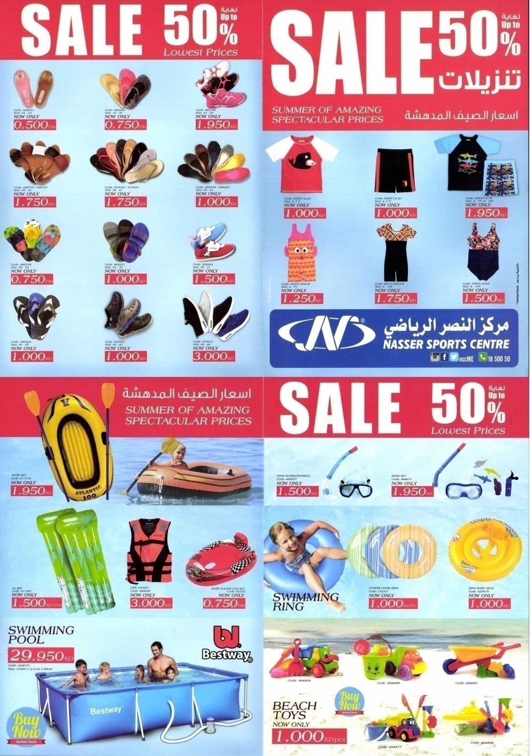
A
D
V
E
R
T
I
S
E
M
E
N
T
4

Slide 45
Incidence of having seen/heard Nasser Sports advertisement – AD 4
By Total Sample & Nationality
About (46%) recall this advertisement. This is highest among Kuwaitis (51%) as opposed to Arabs and Non Arabs
%
Base: Total Sample = 419

Slide 46
MAIN MESSAGE CONVEYED- ALL TEXTS ARE NOT APPEARING
By Total Sample
Base: Seen the Advertisement = 193

Slide 47
Impressiveness of Advertisement
Total Sample & Nationality
Informative nature of Advertisement
Total Sample & Nationality
Top 2 Boxes = 80 75 83 89 79 78 82 77
Total sample (419)
Kuwaitis
(192)
Arab Expats
(157)
Non Arabs
(70)
Total sample (419)
Kuwaitis
(192)
Arab Expats
(157)
Non Arabs
(70)

Slide 48
Credibility of the Advertisement
Total Sample & Nationality
Ease of understanding the Advertisement
Total Sample & Nationality
Top 2 Boxes = 79 80 85 66 88 90 89 80
Total sample (419)
Kuwaitis
(192)
Arab Expats
(157)
Non Arabs
(70)
Total sample (419)
Kuwaitis
(192)
Arab Expats
(157)
Non Arabs
(70)

Slide 49
Effectiveness of Advertisement
Total Sample & Nationality
Colors used in Advertisement
Total Sample & Nationality
Top 2 Boxes = 78 77 84 71 82 86 79 77
Total sample (419)
Kuwaitis
(192)
Arab Expats
(157)
Non Arabs
(70)
Total sample (419)
Kuwaitis
(192)
Arab Expats
(157)
Non Arabs
(70)

Slide 50
Way of writing the Advertisement
Total Sample & Nationality
Pictures in the Advertisement
Total Sample & Nationality
Top 2 Boxes = 79 83 80 66 83 86 84 76
Total sample (419)
Kuwaitis
(192)
Arab Expats
(157)
Non Arabs
(70)
Total sample (419)
Kuwaitis
(192)
Arab Expats
(157)
Non Arabs
(70)

Slide 51
Overall rating of the Advertisement
Total Sample & Nationality
Top 2 Boxes = 88 84 88 96
Total sample (419)
Kuwaitis
(192)
Arab Expats
(157)
Non Arabs
(70)

Slide 52
REASONS FOR DISLIKING THE ADVERTISEMENT
By Total Sample
Base: Average / Disliked the advertisement = 42

Slide 53
Perception of Nasser Sports Advertisement Campaign in the last 3 months vs. Competition
Respondents were investigated on their perception of NSC advertisements in the last 3 months vs. Competition. Majority (45%) have mentioned it is better than Competition implying that the advertisement campaign has been Effective.

Slide 54
Conclusion
The ensuing slides compare the Ad recall levels of the four advertisements of Nasser Sports Spontaneously and after Post Commercial Registration (PCR).
Recall level for Ad 1 is the highest, both at the Spontaneous level as well as after the PCR, even though in both cases the share is the same.
For the other three advertisements, the recall increased by about 10-12% after PCR.
Thus, it is evident that overall the recent advertisement campaigns have been effective.
Further a comparison of the ratings of the 4 advertisements on the different elements have been shown separately.

Slide 55
COMPARISON – Spontaneous vs. PCR Recalls
Advertisement - 1
Advertisement - 2
Advertisement - 3
Advertisement - 4
%
%
%
%

Slide 56
COMPARISON – Rating of elements among NSC’s advertisements
Impressiveness of Advertisement
Total Sample
Informative nature of Advertisement
Total Sample
Top 2 Boxes = 69 74 72 80 65 77 76 79
Ad 1
Ad 2
Ad 3
Ad 4
Ad 1
Ad 2
Ad 3
Ad 4
56

Slide 57
Creditability of Advertisement
Total Sample
Ease of understanding of Advertisement
Total Sample
Top 2 Boxes = 76 77 77 79 75 87 84 88
Ad 1
Ad 2
Ad 3
Ad 4
Ad 1
Ad 2
Ad 3
Ad 4
57

Slide 58
Effectiveness of Advertisement
Total Sample
Colors used
Total Sample
Top 2 Boxes = 74 75 74 78 75 76 74 82
Ad 1
Ad 2
Ad 3
Ad 4
Ad 1
Ad 2
Ad 3
Ad 4
58

Slide 59
Way of writing
Total Sample
Pictures
Total Sample
Top 2 Boxes = 73 73 70 79 73 76 73 83
Ad 1
Ad 2
Ad 3
Ad 4
Ad 1
Ad 2
Ad 3
Ad 4
59

Slide 60
Overall Rating of Advertisements
Total Sample
Top 2 Boxes = 82 82 88 88
Ad 1
Ad 2
Ad 3
Ad 4
60

